Slide 1
Understanding Employee Attrition through HR Data Micro-Project 1
David A. Hall
5/13/2025
Data Repository:
https://github.com/dhall891/ANA500/tree/main

Slide 2

Problem Statement
Employee turnover is a costly issue for companies. Understanding which factors contribute to employee attrition can help organizations take early action to retain valuable talent. This project uses historical HR data to explore patterns and variables linked to employee attrition.

Slide 3

Hypothesis Formulation
Employees with long commute distances, low job satisfaction, and limited career growth are more likely to leave the company.

Slide 4

Acquire Data
Dataset: Employee Attrition.csv
Rows: 1,470
Columns: 35
No missing values were detected.
No duplicate rows found.

Slide 5

Prepare Data
Dropped irrelevant or constant-value columns:
EmployeeCount
EmployeeNumber
Over18
StandardHours
Dataset reduced to 31 relevant columns
Target variable Attrition is imbalanced:
1,233 "No" (still with the company)
237 "Yes" (have left the company)
To address this imbalance in future modeling:
Will consider using resampling techniques such as SMOTE
May also use class weighting in predictive models
Planned feature transformations:
Categorical features such as BusinessTravel, JobRole, and Gender will require one-hot encoding
Numerical features may be normalized depending on the algorithm used
Summary statistics give insight into numeric variables such as:
Age
DistanceFromHome
JobSatisfaction
YearsAtCompany

Slide 6

Analyze Data
Used Seaborn and Matplotlib to explore relationships:
Attrition counts
Distance from home
Job satisfaction
Years at company
Correlation heatmap of numeric features

Slide 7

Report
Employees with longer commutes and lower job satisfaction show higher attrition
Employees with shorter tenure are more likely to leave
Visualization supports hypothesis and guides future modeling focus

Slide 8
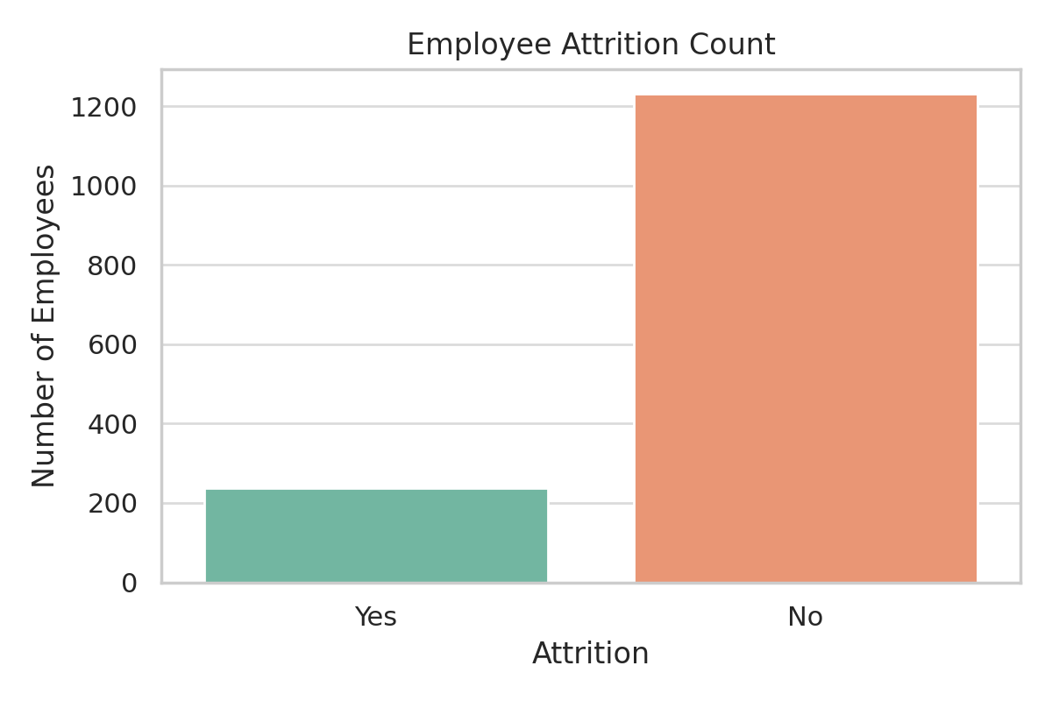
Attrition Count

Slide 9
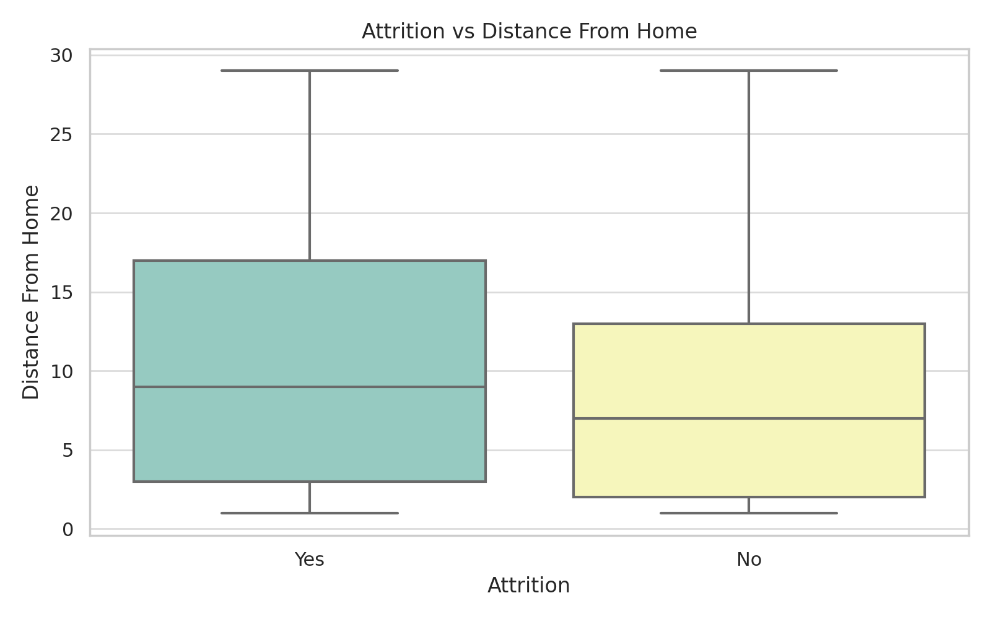
Attrition vs Distance From Home

Slide 10
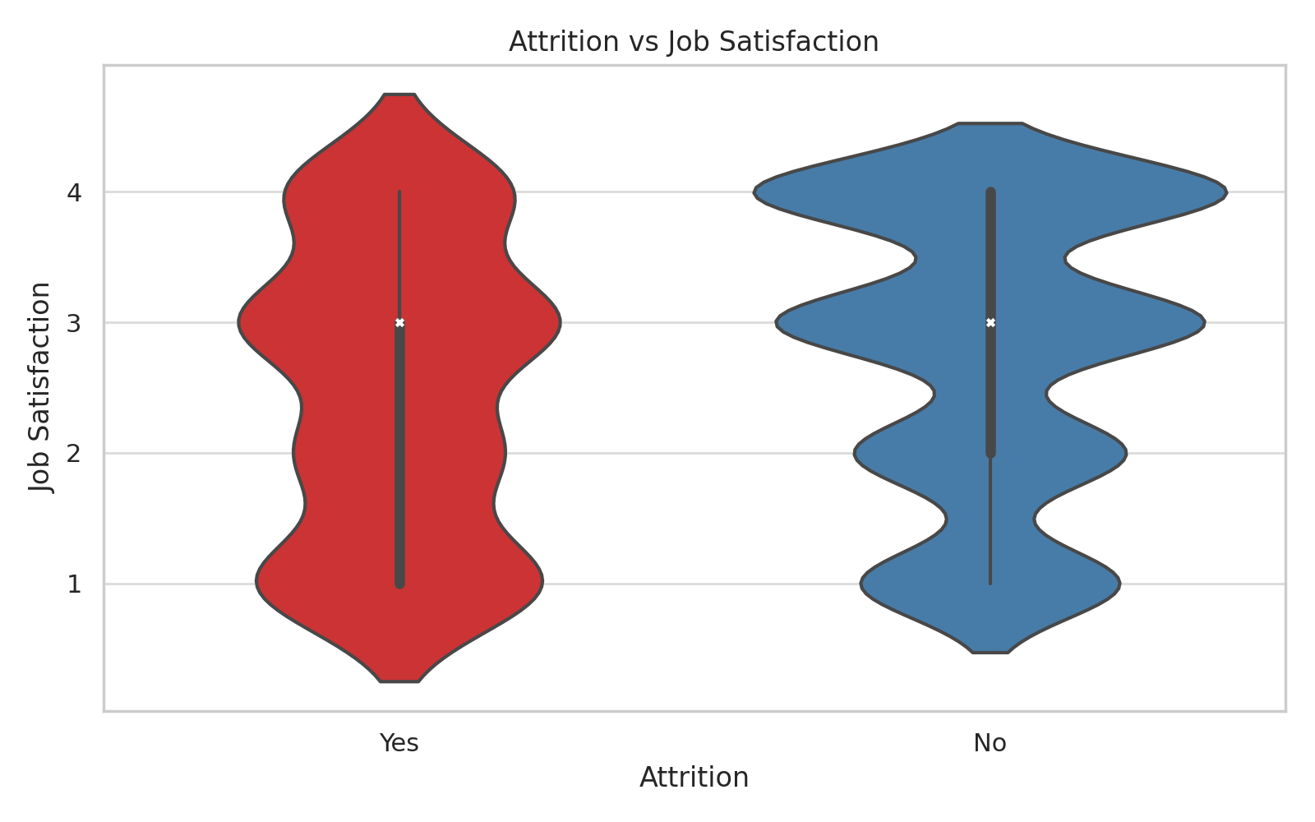
Attrition vs Job Satisfaction

Slide 11
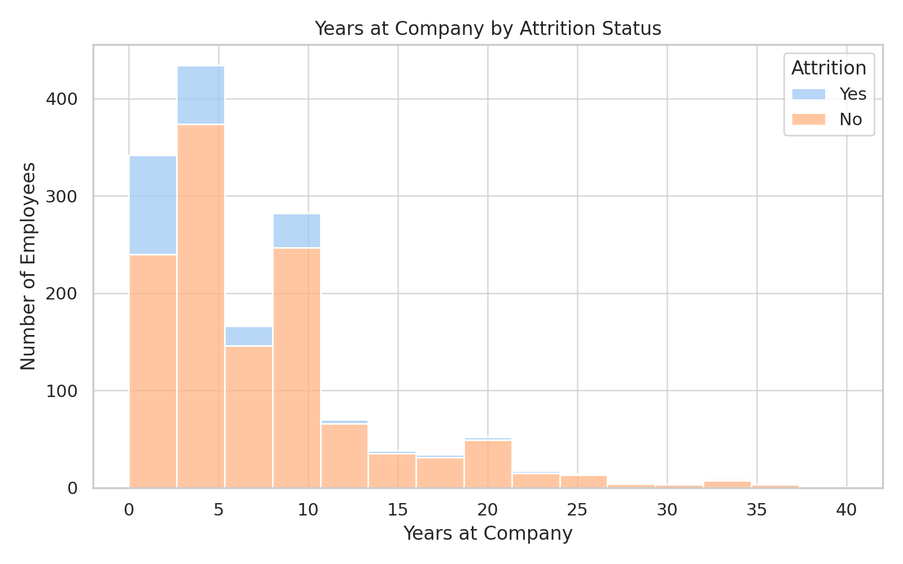
Years at Company by Attrition

Slide 12
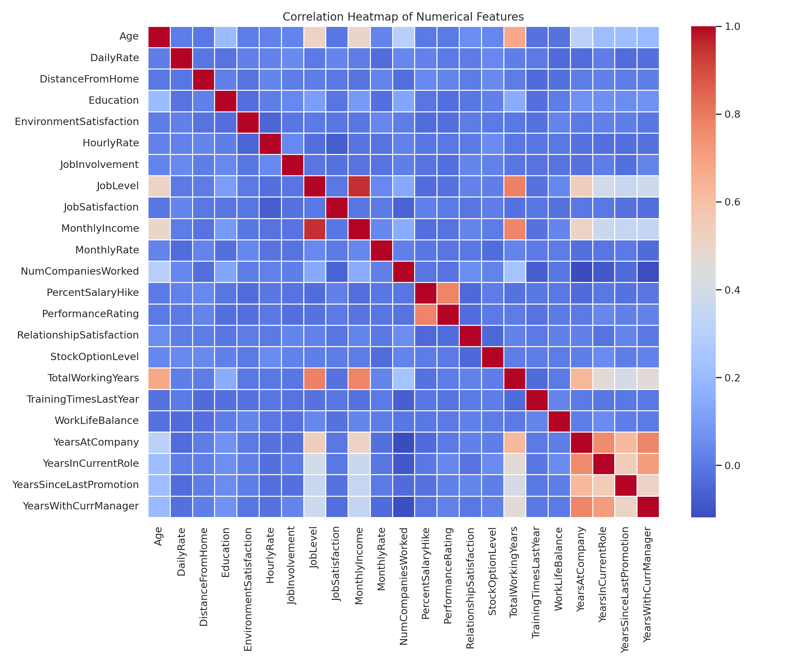
Correlation Heatmap

Slide 13
Act
<apply results, connect results with the chosen problem statement or business question>

